Slide 1
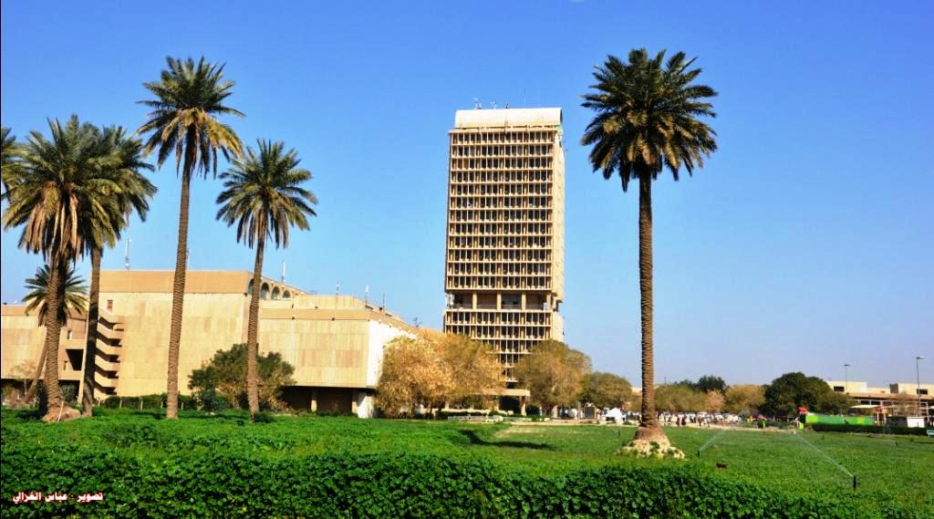
international relationship
University of Baghdad
Assistant Professor , Ayaid K. Zgair Ph.D
Director,
Scholarships and International Cultural Relations
University of Baghdad
Baghdad, Iraq.
Disclaimer: this project has been funded with support from the European commission. This publication [communication] reflects the views only of the author , and the commission cannot be held responsible for any use which may be made of the information contained there in
MediTec Project Number:585980-EPP- 1-2017- 1-DE- CBHE-JP

Slide 2
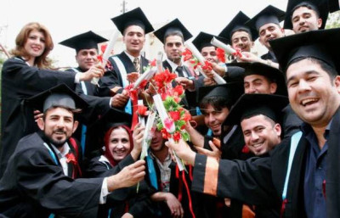
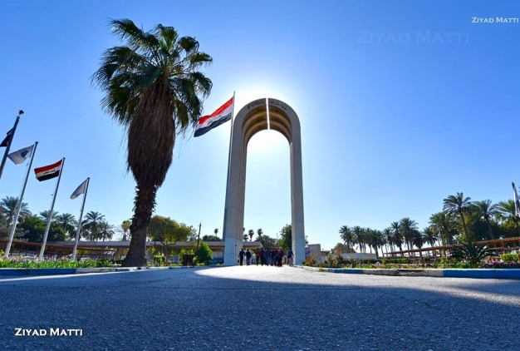
Overview
Biggest, oldest and most prestigious
University in Iraq
Established in 1957.
It includes 24 colleges, 4 institutes, 9 scientific
centres and 15 research units.
78,000 students enrolled in the University,
69,000 undergraduate and 9,000 postgraduate
students, and more than 7,000 faculty members.
MediTec Project Number:585980-EPP- 1-2017- 1-DE- CBHE-JP

Slide 3
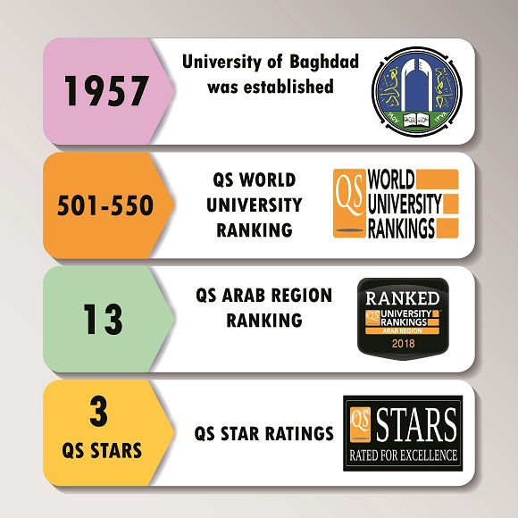
QS Ranking
MediTec Project Number:585980-EPP- 1-2017- 1-DE- CBHE-JP

Slide 4
Mission of UoB
Building population and developing the society.
learning, teaching, doing researches and serving.
The university undertakes to prepare productive and self- reliable graduates.
Find the scientific solutions to our country issues.
Emphasizes the integration of the theoretical and practical knowledge and the rehabilitation to accomplish the academic accreditation.
MediTec Project Number:585980-EPP- 1-2017- 1-DE- CBHE-JP

Slide 5
International Programs
We have several scientific and cultural programs with International organizations and institutions (Last 5 years):
Memorandum of understanding (MoU).
Twining programs.
Cooperation with international organizations.
Scholarships.
Visiting Professor Program.
Ph.D research Programs.
Conferences.
MediTec Project Number:585980-EPP- 1-2017- 1-DE- CBHE-JP

Slide 6
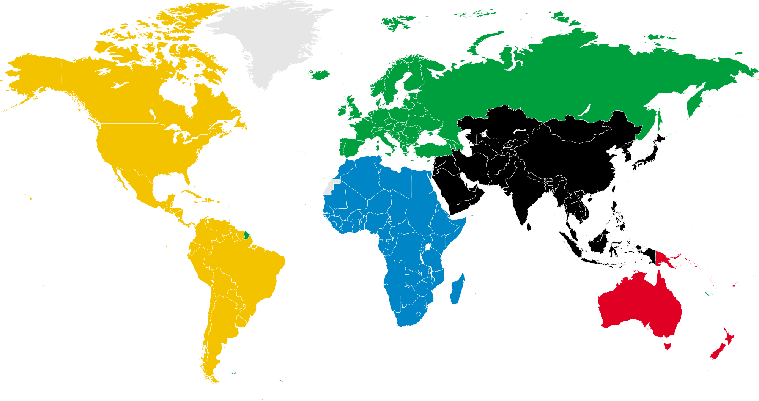
MoUs
Germany (4)
Italy (3)
England (6)
France (2)
Turkey (2)
Greece (1)
Sweden (2)
Spain (2)
Poland (2)
Russia (2)
Netherlands (1)
US (8)
Japan (1)
Korea (1)
China (1)
Malaysia (2)
Philippines (1)
India (1)
Iran (5)
UAE (1)
Egypt (2)
Australia (2)
MediTec Project Number:585980-EPP- 1-2017- 1-DE- CBHE-JP

Slide 7
Twining Program
University of Freiburg; Germany
Amirkabir University of Technology, Iran
Swin Burin University of technology, Australia
MediTec Project Number:585980-EPP- 1-2017- 1-DE- CBHE-JP

Slide 8
Cooperation with international organizations
ERASMUS+ (4+3)
IREX,
USA (4)
DAAD, Germany (1+2)
MediTec Project Number:585980-EPP- 1-2017- 1-DE- CBHE-JP

Slide 9
Scholarships
Europe 583
Japan (4)
Korea (3)
China (15)
North America (187)
Malays (122)
India (26)
Iran (29)
Egypt (55)
Australia (50)
New Zealand (5)
MediTec Project Number:585980-EPP- 1-2017- 1-DE- CBHE-JP

Slide 10
Visiting Professor Program
Germany (16)
Italy (9)
England (17)
France (2)
Netherlands (1)
USA (8)
Canada (5)
Egypt (5)
Malaysia (10)
Iran (3)
Other (3)
Australia & New Zealand (5)
MediTec Project Number:585980-EPP- 1-2017- 1-DE- CBHE-JP

Slide 11
Ph.D students research abroad
Germany (13)
Italy (6)
England (10)
Netherlands (1)
Japan (2)
China (4)
USA (16)
Canada (12)
Australia & New Zealand (4)
MediTec Project Number:585980-EPP- 1-2017- 1-DE- CBHE-JP

Slide 12
Conferences and meetings
Total:
1670 Professors
MediTec Project Number:585980-EPP- 1-2017- 1-DE- CBHE-JP

Slide 13
Developing International Relations
Signing new MoUs
Increase the scholarships opportunity.
Increase the joint supervision of postgraduate students (Ph.D and MSc.).
Increase the exchange of professors and students with International institutions especially European universities.
Provide opportunities for graduate students to complete some of their experiments in the EU university laboratories.
Increase the number of joint conferences with EU universities in Iraq.
Exchange of scientific information.
Cultural exchange.
Other activities.
Work on the development of scientific and cultural projects supported by some International organizations (EU).
Increase the chance of e-learning for communication between students and professors.
Others.
MediTec Project Number:585980-EPP- 1-2017- 1-DE- CBHE-JP

Slide 14
Thank you
MediTec Project Number:585980-EPP- 1-2017- 1-DE- CBHE-JP

